Slide 1
Rethinking Economic Development
TBED in Context

Slide 2
Technology Based Economic Development
Design Thoughts
Economies are beginning to focus on a “Grow Our Own” strategy. In light of today’s view of the future:
Overlay I/E and Retention in our TBED thinking
Bridge the gap between I/E and Retention Ecosystems
Link Talent, Assets and Capital Resources
Align components to avoid duplication and sub-optimization

Slide 3
Overlay I/E and Retention in our TBED thinking
Often they are disjoint

Slide 4
An Economy’s Needed Economic Development Focus
Create
Retain
Recruit
Companies That Fill Gaps
New Ventures in Cluster &
Emergent Areas
Expanding Companies & Critical Industries

Slide 5
I&E, Recruitment and Retention
If Theme is: Grow Our Own
Subthemes are:
  Complement Our Own: Strategic Recruitment to Fill Gaps
  Create Our Own: Build Upon on I&E Activity
  Keep Our Own: Increase Emphasis on Retention
  All Recruitments & Startups Require Retention!!

Slide 6
Bridge I/E and Retention Ecosystems
Innovation Applies Beyond Startups & Employment Growth Takes Time

Slide 7
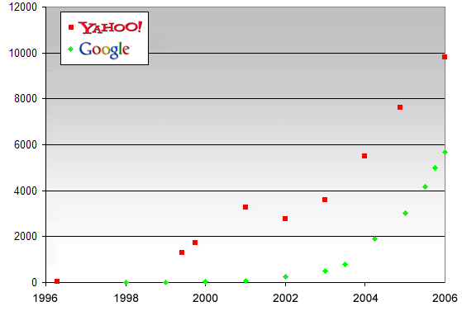
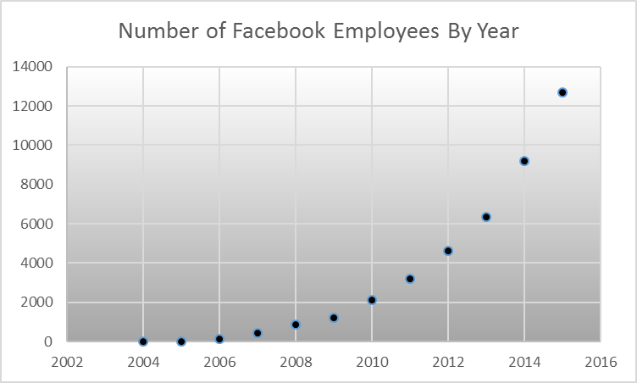
Growth in time examples
Public Data
Tales of Creation,
Gabor, Cselle: Blog Post for Saturday, Feb. 18, 2006

Slide 8
Need Startups To Survive ….
National Governors Association: Growing State Economies Policy Framework, 2013

Slide 9
… To Thrive
Accumulation of High Growth Companies Drives TBED
National Governors Association: Growing State Economies Policy Framework, 2013

Slide 10
Who Minds the Gaps?
Linkage of Ecosystems Is Beyond Level of Any University

Slide 11
Linking & Pilot Programs Connecting
Talent, Assets and Capital Into Innovation Action
But Universities Can Help If Supported In

Slide 12
Innovation-side
Technology Based Economic Development Efforts
Assets
Capital
Talent
Unique Programs Addressing Tech Uptake Capacity at SME’s
University-based innovations that can be transferred, unique facilities and

Slide 13
Linking Programs to Connect Elements
Assets
Capital
Talent
Training and Manpower Programs
Research Universities
Incubators, Accelerators
Tech Supportive Infrastructure
Programmatic Funds (TAP, Government); Seed, Angel, Venture; Traditional

Slide 14
Innovation Program Gaps
Lack of Programs for Existing SME’s
  Limited Programs Exist
  Broaden Program Portfolio – especially ones that link elements
Connect Talent, Assets, Capital Through Programs Supporting
  Action
  Coordination

Slide 15
Innovation Programs - SME Examples
Subsidy Programs for SME’s to:
Access resources, e.g., testing, r&d or training support at universities – voucher program?
Receive I&E support via accelerators and incubators, e.g., pivot and new product/business expansion
Connect to government-supported programs, e.g., technical internships in disciplines of economic importance
Receive better capital access by participation in risk-reducing I&E programs

Slide 16
Innovation Programs – continued
Action Focused SME Partnerships
Enhanced Programs in Tech Transfer
Link training programs with tt-based SME support (e.g. MBA woman entrepreneurs as simultaneous EIR-opportunity on behalf of SME)
Funds support for engagement
  Prototype / proof of application with SME’s wanting to adopt university technology to enhance or extend product offerings
  Include student or postdoc support and SME hiring to create technology carrier and enhance SME uptake capability

